Slide 1
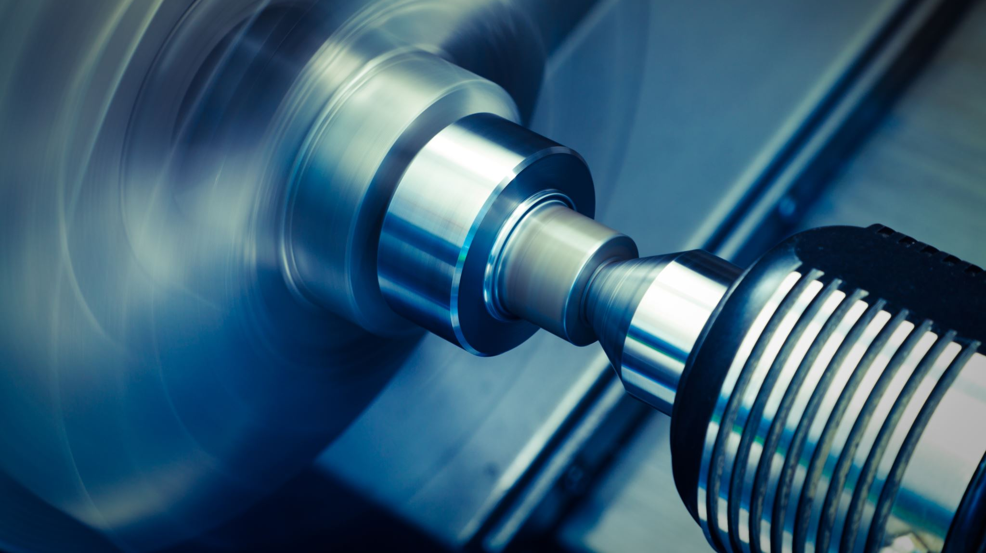
Digital Twin of a Rotating Shaft for Predictive Maintenance using MATLAB Simulink and Simscape
MDM2104 – Case Study: Intelligent Systems in Production
Group 9
Sameer K. Subair
Karthik Gopi
Nihal Sait Nishan
Abdul Rashid Kundladi

Slide 2
Obectives
Main Objective:
To develop a digital twin of a rotating shaft system capable of simulating healthy and faulty conditions for predictive maintenance.
Specific Objectives:
Build a baseline digital twin model using MATLAB Simscape.
Integrate sensors for torque, speed, and vibration measurement.
Introduce fault scenarios (unbalance, bearing wear, misalignment, cracked shaft).
Compare healthy vs faulty signals using FFT and RMS analysis.

Slide 3
Problem & Industrial Relevance
Real-World Problem:
Lack of reliable Remaining Useful Life (RUL) prediction for critical rotating components (e.g., shafts, turbines, motors). Failures lead to downtime and high maintenance costs.
Traditional Limitation:
Conventional maintenance (time-based or reactive) detects faults but cannot predict when failure will happen.
Project Goal:
To develop a digital twin-based predictive maintenance system for rotating shafts — using MATLAB Simulink for simulation and AI (LSTM) for RUL prediction.

Slide 4
Research Gap & Tools
Research Gap:
Most digital twin models are either too simple (low accuracy) or too complex (computationally heavy).
Our project finds a balance by creating a physics-based shaft twin capable of generating realistic fault data.
Tools & Methods:
Tool | Purpose
MATLAB/Simulink | Digital twin modeling & synthetic data generation
Kaggle dataset | Real-world data for AI model training
LSTM | Remaining Useful Life (RUL) prediction
Digital Twin | Virtual verification of predictions

Slide 5
Literature Review & Key References
Raja Singh et al., 2023 – “Building a Digital Twin Powered Intelligent Predictive Maintenance System for Industrial AC Machines” (MDPI)
Demonstrated DT integration for motor health monitoring.
Han et al., 2022 – “Overview of Predictive Maintenance Based on Digital Twin Technology” (Mechanical Systems & Signal Processing)
Reviewed methods for digital twin-driven fault diagnosis in rotating systems.
Gap Identified:
Existing work focuses on high-level system modeling.
This project focuses on shaft-level simulation using MATLAB Simscape — providing deeper insight into component behavior.

Slide 6
Core Simulink Model
Components:
Ideal Torque Source (motor input)
Rotational Spring & Damper (shaft stiffness & damping)
Inertia (shaft mass)
Motion & Torque Sensors
Mechanical Reference + Solver Configuration
Outputs:
Torque signal → out.torque_out
Angular velocity → out.omega_out
Vibration signal → out.vibration_signal
Result (Healthy Condition):
Smooth acceleration to steady-state speed.
Torque constant, no oscillations.
Represents stable shaft operation.

Slide 7
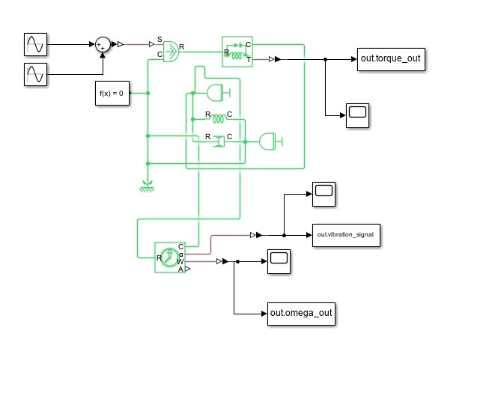
Core Simulink Model

Slide 8
Baseline Result: Healthy Shaft
Observation:
Angular velocity increases and stabilizes → healthy rotation.
Torque output constant (steady-state).
Vibration signal low and stable.
Interpretation:
The digital twin baseline confirms realistic mechanical dynamics of the shaft under normal operating conditions.

Slide 9
Fault Injection Overview
Fault Type | What It Does Physically | How It’s Modeled
Unbalance | Centrifugally oscillating moment at shaft speed | Increase Sine Wave amplitude on torque input (0.1→0.5 N·m)
Bearing Wear | Less damping → higher vibration resonance | Reduce Rotational Damper C from 0.02 → 0.002
Misalignment | Introduces 2× shaft-speed harmonic | Add Sine Wave with 2× fundamental frequency
Cracked Shaft | Weakens stiffness, lowers resonance frequency | Decrease Spring constant K by 50%

Slide 10
Simulation: Fault Condition
Example Fault: Bearing Wear / Unbalance
Fault introduced by reducing damping coefficient and increasing input torque variation.
System exhibits increased vibration and torque fluctuations.
Data recorded for FFT and RMS comparison.

Slide 11
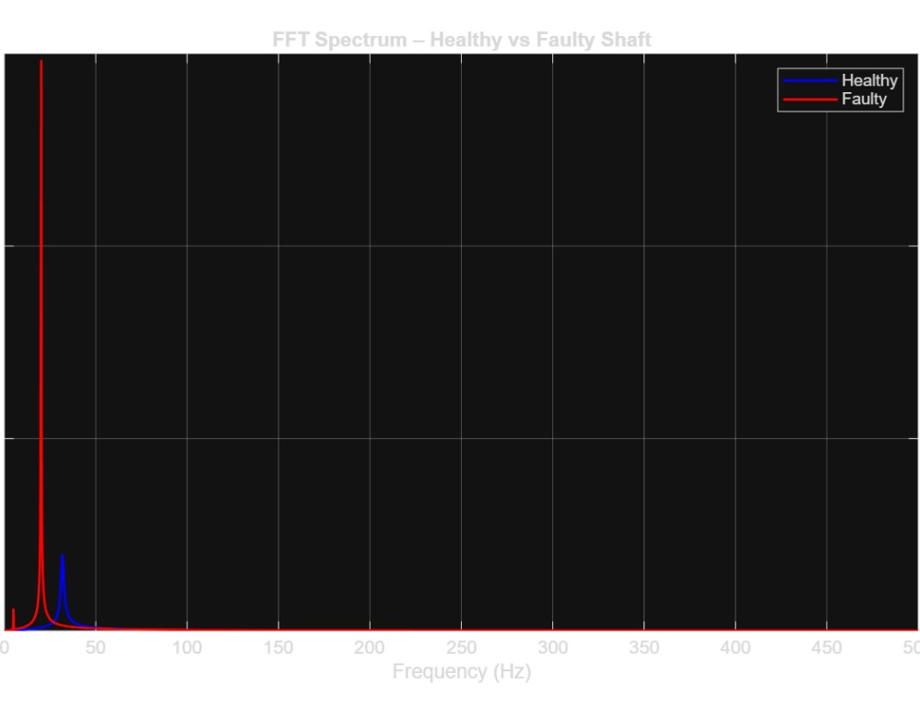
FFT Spectrum: Healthy vs Faulty Shaft
Healthy shaft (blue): single dominant frequency peak at normal shaft speed.
Faulty shaft (red): higher amplitude + additional harmonics → indicates imbalance or wear.
Interpretation:
FFT helps identify fault signatures in the frequency domain.

Slide 12
Feature Extraction (RMS & Peak Frequency)
Condition | RMS | Peak Frequency (Hz) | Prediction | Confidence | True Label
Healthy | 4.45 | 31.79 | Healthy | 0 | Healthy
Faulty | 13.88 | 20.19 | Faulty | 1 | Faulty
Insight:
RMS value significantly higher in faulty condition → stronger vibrations.
FFT peak shift indicates structural imbalance.

Slide 13
Interpretation & Takeaways
Fault introduction successfully simulated in the digital twin.
Signal analysis confirms clear distinction between healthy and faulty states.
FFT and RMS are effective fault indicators.
Digital twin provides virtual fault data for training predictive models (e.g., LSTM).

Slide 14
Challenges & Solutions
Challenge | Description | Solution
Non-convergent model | Overconstraint between sensors | Reconnected reference paths & solver configuration
Continuous acceleration | No resistive load | Added rotational damper & load torque
Fault injection instability | High torque amplitude | Gradual amplitude increase (0.1 → 0.5 N·m)
Feature overlap | Hard to see small RMS differences | Used FFT and separate signal plots for comparison

Slide 15
Next Steps
Generate more fault data (different damping/stiffness levels).
1
Automate feature extraction (RMS, FFT peaks).
2
Train LSTM model for Remaining Useful Life (RUL) prediction.
3
Validate predictions against digital twin ground truth.
4

Slide 16
Conclusion
Digital twin successfully models healthy and faulty shaft conditions.
FFT & RMS analysis validate vibration-based fault signatures.
Foundation ready for AI-based predictive maintenance in Phase 4 (LSTM Prognostics).

